Slide 1
Product 2D Dimensions

Slide 2
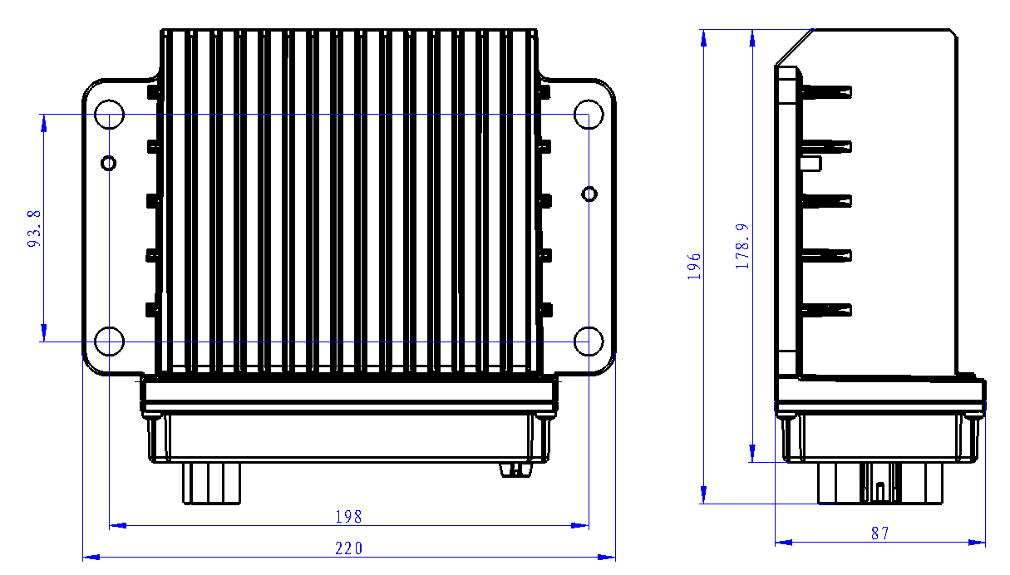
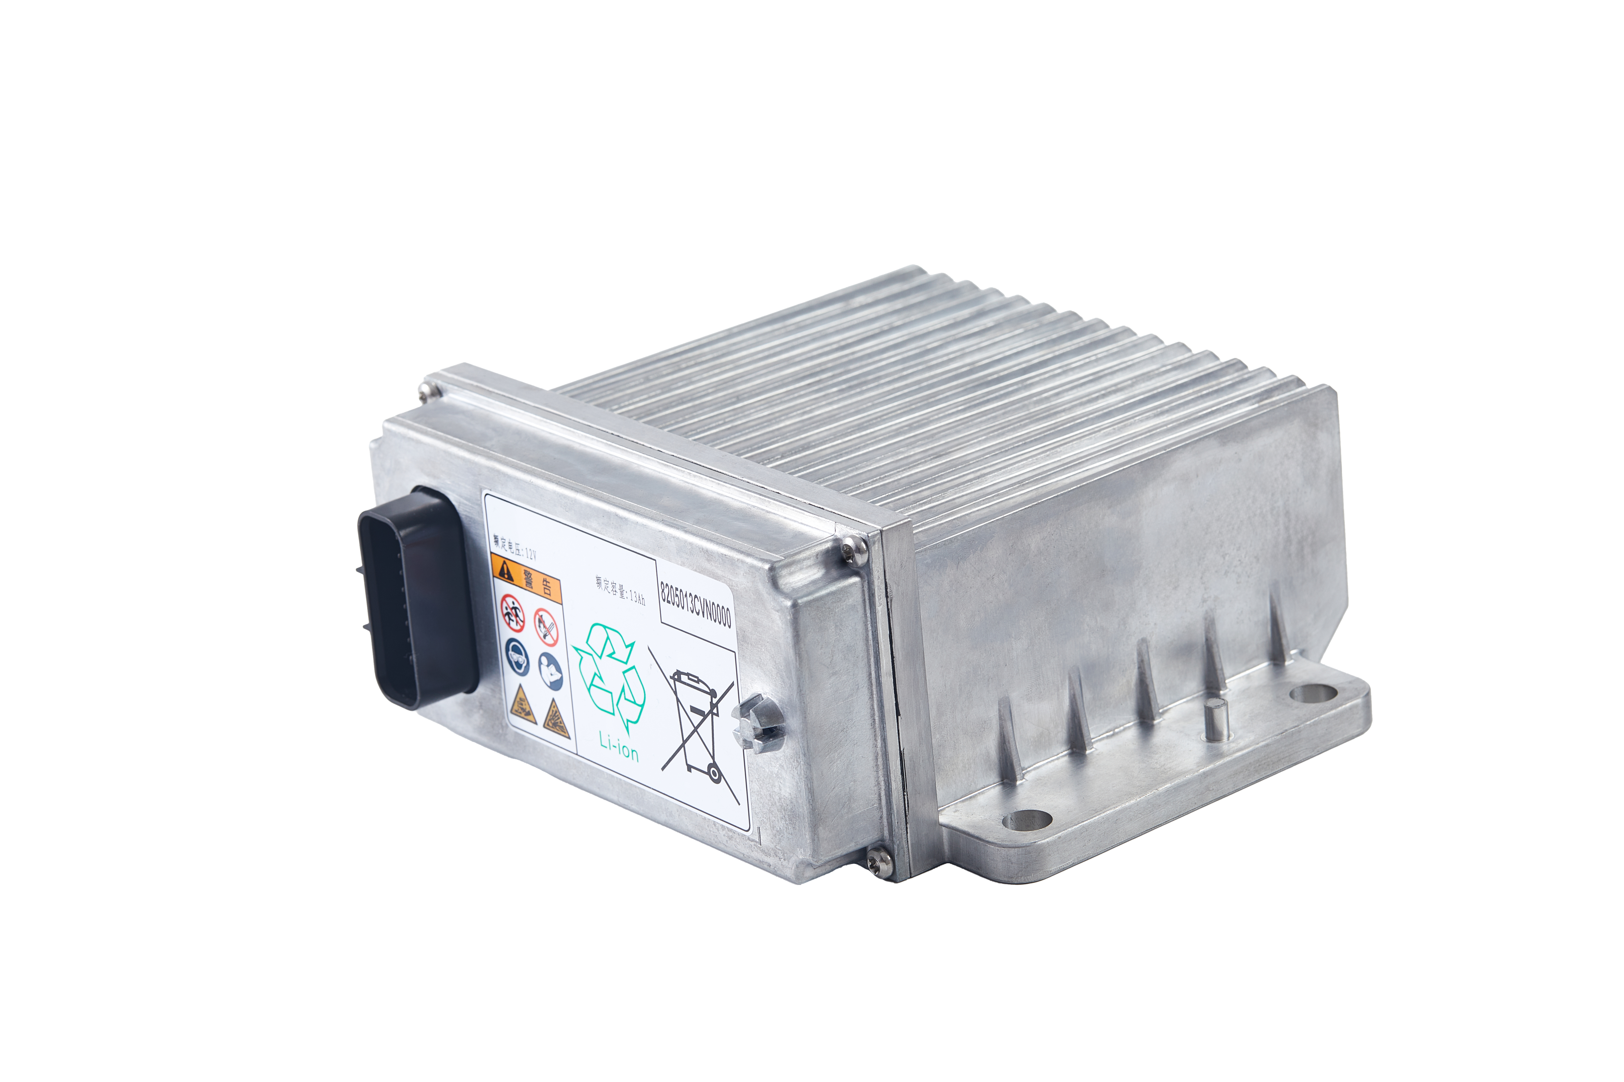
1 12V 13Ah Backup Battery ASIL C

