Slide 1
Product 2D Dimensions

Slide 2
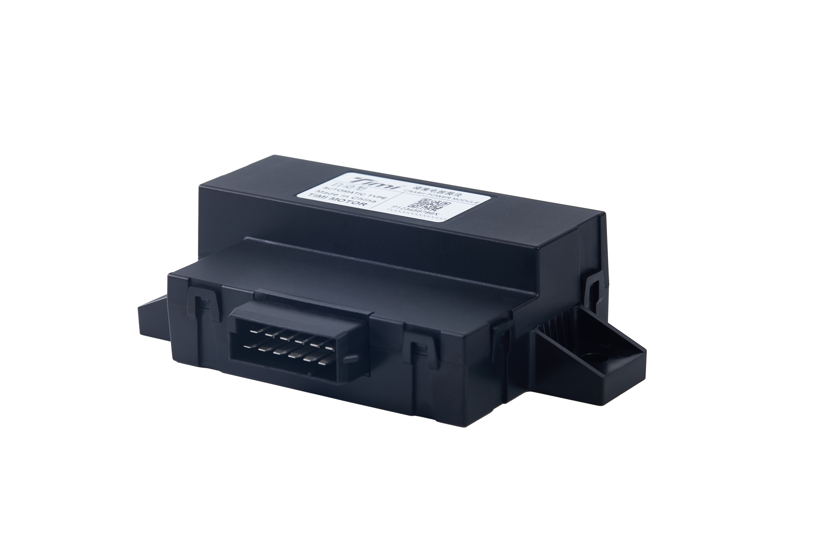
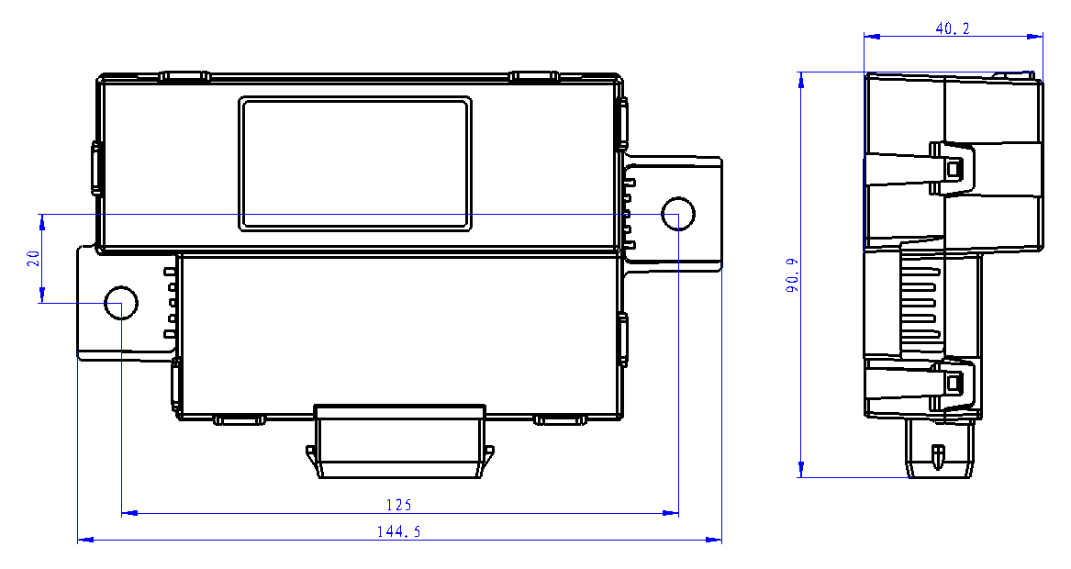
12V CPM_5F_Trigger Type

Slide 3
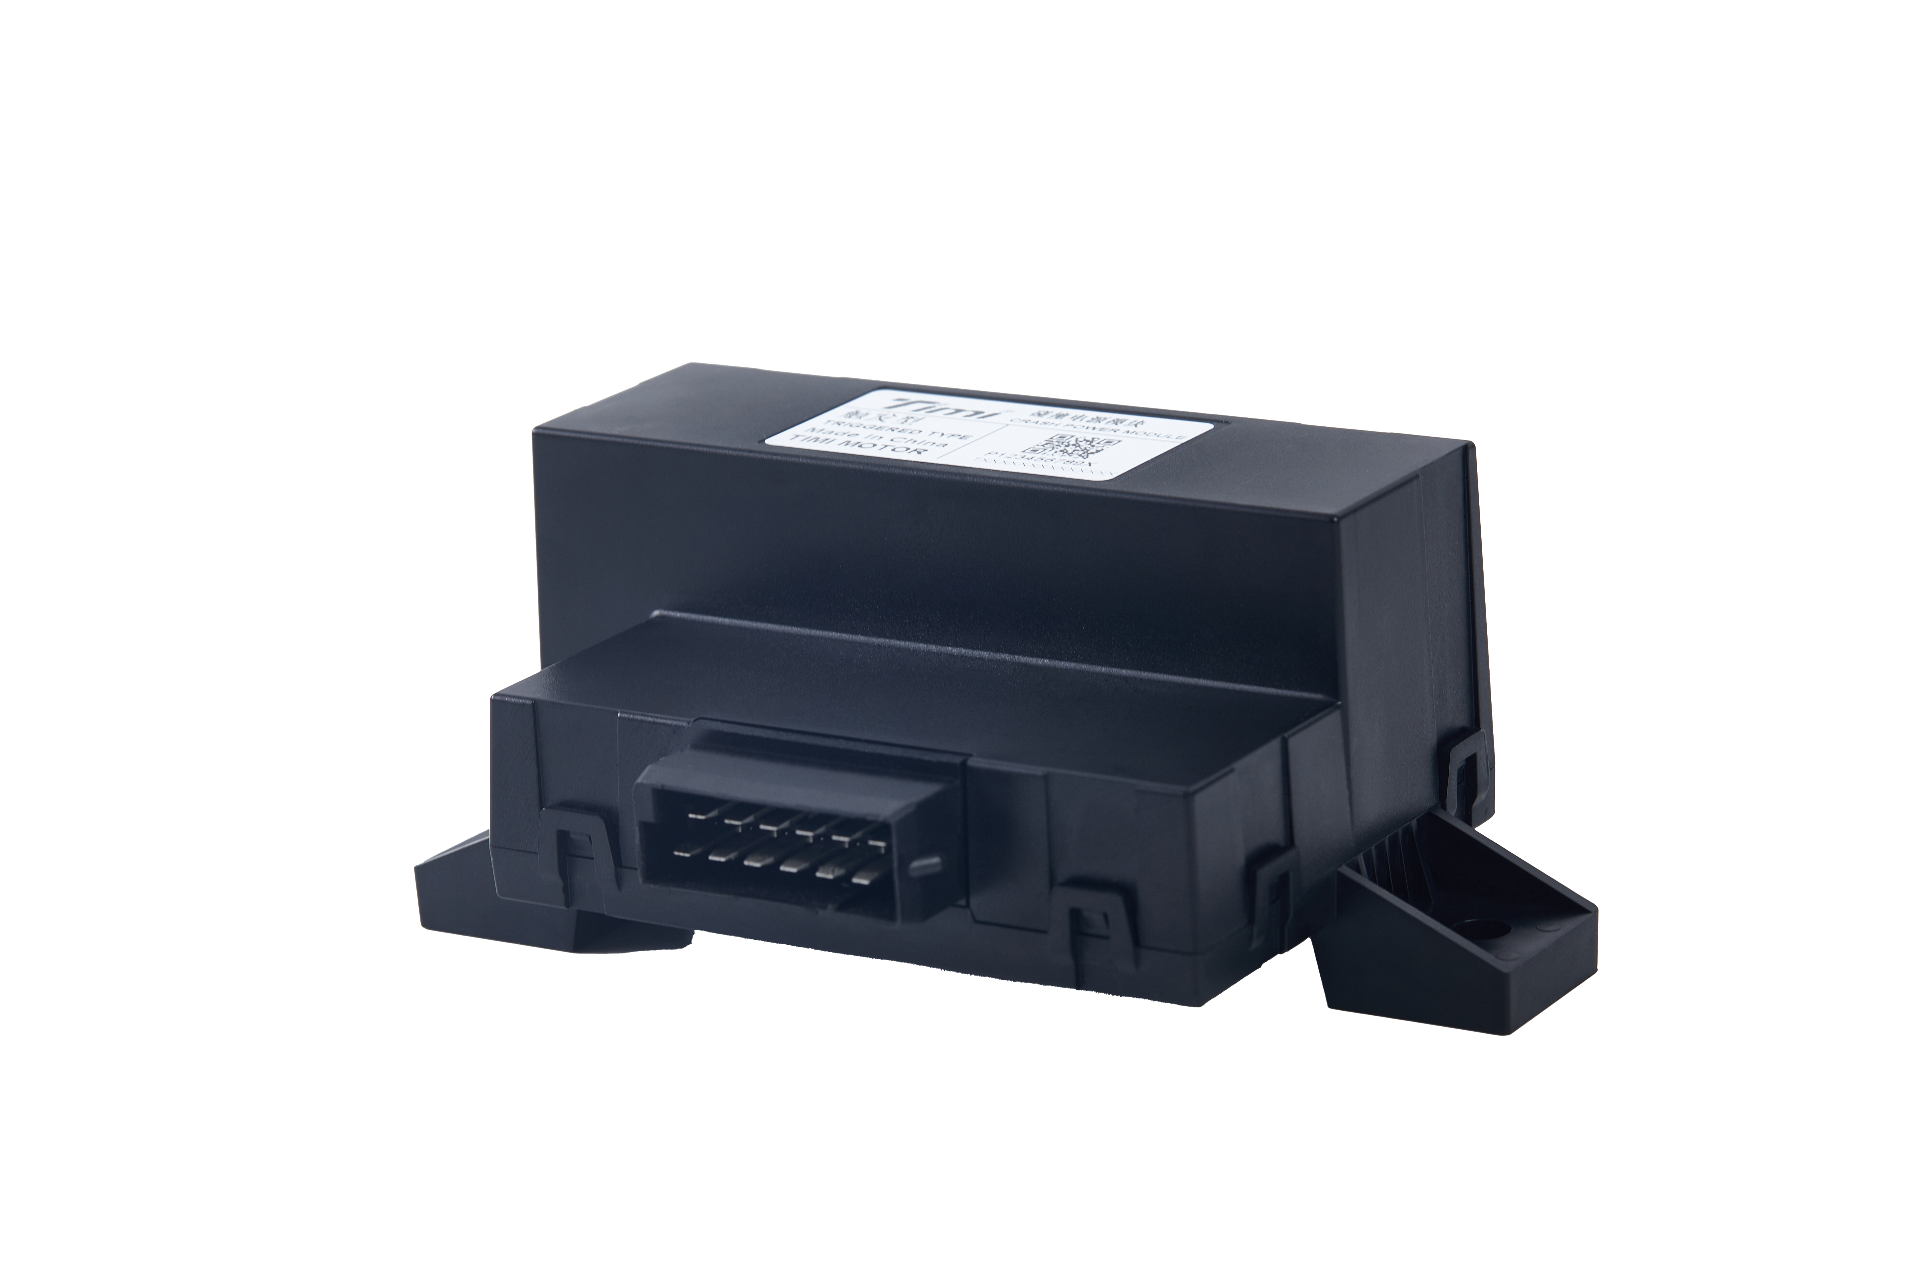
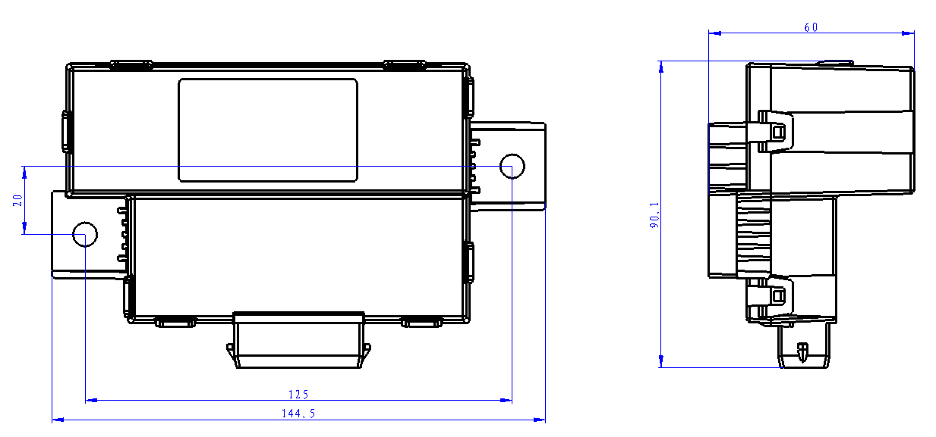
12V CPM_5F_Auto Type

